Slide 1
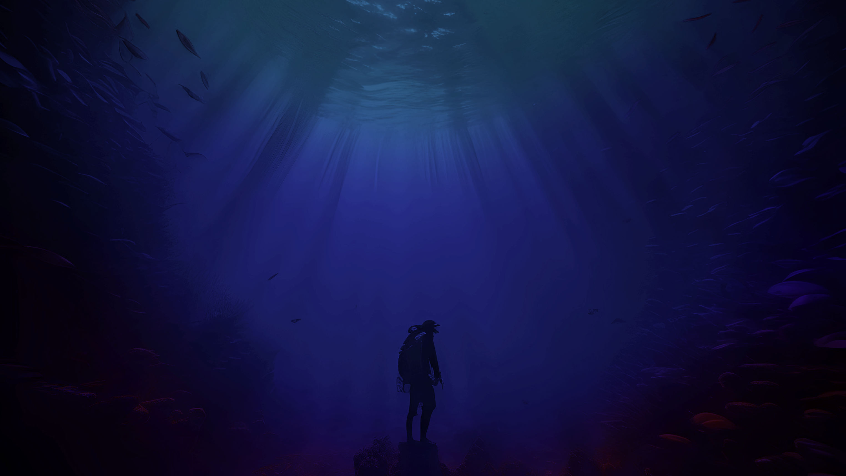
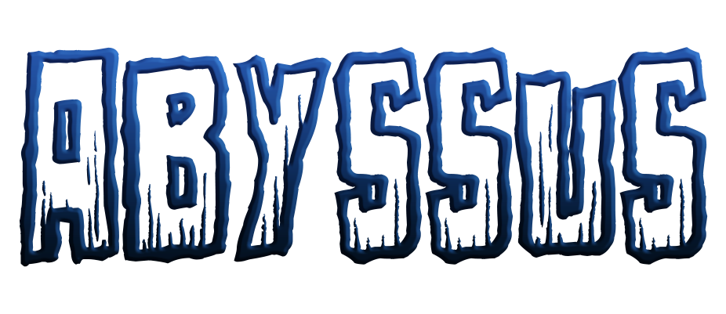

by

Slide 2
LIVE DEMO

Slide 3
Submarine Level

Slide 4
Cave Level

Slide 5
Brand

Slide 6
Art

Slide 7
Narrative

Slide 8
Audio

Slide 9
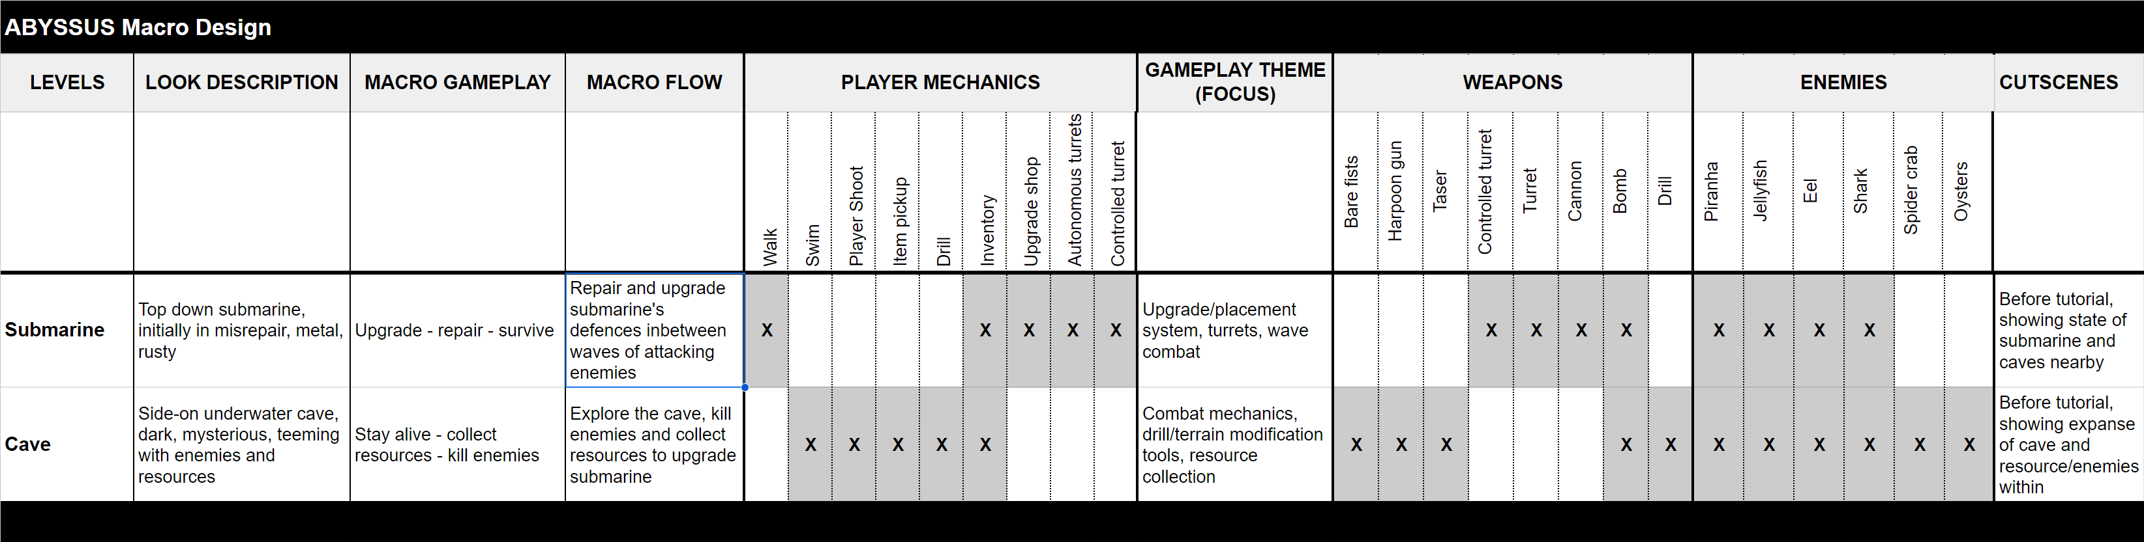
Macro Design

Slide 10
Business Plan
Platforms
Windows, WebGL
Would be possible to build for Mac
Good possibility for a mobile platform
Target Demographic
Survival and horror game enjoyers
Pixel art enjoyers
Time rich
Any race, sex, religion or ethnicity

Slide 11
Business Plan
Challenges
The name Abyssus already exists on a game on steam
Horror games have a more niche target demographic
Limited target audience because of platform limitations
2D pixel art games are common in the game industry
People with thalassophobia would avoid this game
Strategies
Legally acquire the name Abyssus or change the name to be original and
Build the game for all platforms including mobile
Make a more unique and consistent art style that makes the game stand out

Slide 12
Business Plan
Promotion & Distribution
Move the game to Steam as well as Itch
Cinematic and gameplay trailers on Steam and Itch
Giving copies to streamers and Youtubers
Social media platforms such as Instagram, X, TikTok etc.
Cost
PAX Booth
https://east.paxsite.com/en-us/registration.html#:~:text=BUY%20NOW-,EXHIBITOR%20REGISTRATION,you%20can%20provide%20is%20helpful!
Screen Australia Grant
https://www.screenaustralia.gov.au/funding-and-support/online/games
IGEA Incentive
https://igea.net/wp-content/uploads/2020/03/Government-Incentives-for-Game-Developers-in-Australia-200324.pdf

Slide 13
THE FINAL QUESTION
Is your game fun and should you continue development?

Slide 14
YES
except…

Slide 15
by
Play it now at
https://oezyowen.itch.io/abyssus

